Slide 1
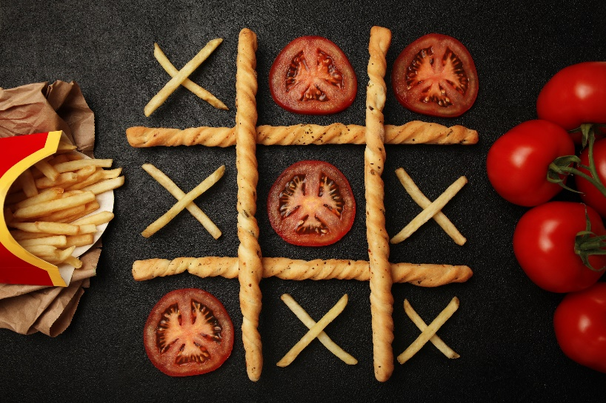
Tic Tac Toe Example
Functional Implementation
Finding the Objects
Defining the API

Slide 2
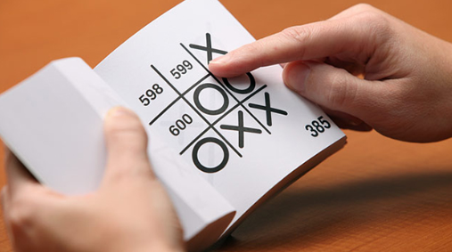
See Also
https://www.amazon.com/Tic-Tac-Autonomous-Playing-Book/dp/1594746877
https://towardsdatascience.com/tic-tac-toe-creating-unbeatable-ai-with-minimax-algorithm-8af9e52c1e7d
Notes:
Here is some additional reading about the web … on the web

Slide 3
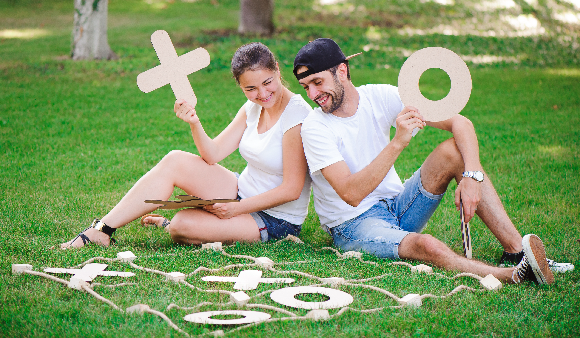
What objects do you see?
Two Players
Computer, human, others?
Has a token
Hat
Tree
Grass
Timer
Tokens
Exactly 2 kinds
Shoes
Game Board
Cells
Exactly 9 cells
Starts empty
Rules about wins and tie
Relationship! Can have zero or one token
Can’t change during play
Notes:
If there is a timer, should it belong to player 1? Or the board?

Slide 4
K.I.S.S
# Loop Until Game Over
# Ask player 1 for their move
# Put an X on the board there
# Check for win
# Check for tie
# Ask player 2 for their move
# Put an O on the board there
# Check for win
# Check for tie
# Loop Forever
# Loop over 1 and 2
# Ask player N for their move
# Put token N on the board there
# Check for win
# Check for tie
# Loop Forever
# Loop over 1 and 2
# Ask player N for their move
# Put token N on the board there
# Check board status
Notes:
Same as OO process
There can’t be a tie after player 2 (odd number of cells). #1 But it doesn’t hurt, and if we add it then the steps are the same#2.
#3 OK. They aren’t exactly the same, but we can parameterize the differences and pass them into the block of code #4 Like this. We pass the player and the token are independent of the code – not hard coded like before.
The code is less efficient. We waste time with a needless tie-check. We also waste time setting up a loop and pulling out the token and player (hard-coding is much faster) But we get SOFTWARE REUSE of code we’ve already written. Efficiency or Reuse? Fewer instructions mean less chance of mistakes. Easier to understand (think maintain). Is that worth the cost of runtime?
We also want our code to be as safe as possible. #5 Notice that the order of these checks is critical. The game can be a win without having an empty space, say if X wins on the last move. We can do some planning up front and avoid that gotcha completely!
#6 How about we check for win and tie with the same helper function. Afterall, both checks require looping over the entire board.

Slide 5
Information Types
C++
enum PLAYER {
PLAYER_1, PLAYER_2
};
int ask_for_move(bool is_player_1) {
return 0;
}
int ask_for_move(int player_num) {
return 0;
}
int ask_for_move(PLAYER player) {
return 0;
}
enum Player {
PLAYER_1,PLAYER_2
}
int ask_for_move(Player player) {
return 0;
}
Java
int move = ask_for_move(true);
int move = ask_for_move(Player.PLAYER_1);
int move = ask_for_move(1);
def ask_for_moveA(is_player_1):
pass
move = ask_for_moveA(True)
move = ask_for_moveA(is_player_1=True)
move = ask_for_moveA("player1")
move = ask_for_moveA(PLAYER_1)
Python
int move = ask_for_move(PLAYER_1);
Notes:
Same as OO functions
Speaking of “helper functions”, let’s go ahead and think about functions we’ll need. What arguments to they take? What do they return? I’ll use C++ here since it forces us to think clearly about what the data is.

Slide 6
Functions
enum BOARD_STATUS {
PLAYING, TIE, WON_1, WON_2
};
int ask_for_move(int player_num) {
return 0;
}
void place_token(int cell_num, int player_num) {
}
int get_board_status() {
return -1; // Still going
return 0; // Tie
return 1; // Player 1 won
return 2; // Player 2 won
}
void print_board() {
}
C++
0 - 8
def get_board_status():
return 'playing'
return 'tie'
return 'won_1'
return 'won_2'
Python
Not a continuum

Slide 7
Game Logic
playing = True
while playing:
for player in [1,2]:
move = ask_for_move(player)
place_token(move,player)
status = get_board_status()
if status == 'won_1':
print('Player 1 won')
playing = False
break
elif status == 'won_2':
print('Player 2 won')
playing = False
break
elif status == 'tie':
print('It is a tie')
playing = False
break
print_board()
Python
board = [0,0,0,0,0,0,0,0,0] # [0]*9
# 0=empty, 1=player1, 2=player2
def ask_for_move(player_num):
# Print the board to show status
# Read int from keyboard
# Error check input and cell
pass
def place_token(move,player_num):
board[move] = player_num
def get_board_status():
pass
def print_board():
print(board)
Python
Notes:
See? We don’t need that fancy OO stuff! Objects … pffft.

Slide 8
Reuse?
playing = True
while playing:
for player in [1,2]:
move = ask_for_move(player)
place_token(move,player)
status = get_board_status()
if status == 'won_1':
print('Player 1 won')
playing = False
break
elif status == 'won_2':
print('Player 2 won')
playing = False
break
elif status == 'tie':
print('It is a tie')
playing = False
break
print_board()
Python
Global – collisions?
board = [0,0,0,0,0,0,0,0,0] # [0]*9
# 0=empty, 1=player1, 2=player2
def ask_for_move(player_num):
# Print the board to show status
# Read int from keyboard
# Error check input and cell
pass
def place_token(move,player_num):
board[move] = player_num
def get_board_status():
pass
def print_board():
print(board)
Tightly coupled
Hardcoded to one global board
Notes:
Could pass the board structure to the functions. That’s exactly what we do with objects, but the syntax is easier.
The game logic doesn’t care where the move comes from. Yet the implementation to use is hardcoded … no room for additional move-makers (like computer players). No mechanism to allow for others.

Slide 9
Evolution to Objects
board = [0,0,0,0,0,0,0,0,0]
def place_token(move,player_num):
board[move] = player_num
def get_board_status():
pass
def print_board():
print(board)
place_token(8, 1)
board = [0,0,0,0,0,0,0,0,0]
board2 = [0,0,0,0,0,0,0,0,0]
def place_token(brd,move,player_num):
brd[move] = player_num
def get_board_status(brd):
pass
def print_board(brd):
print(brd)
place_token(board, 8, 1)
place_token(board2, 5, 2)
Python
Python
class Board:
def __init__(self):
self.cells = [0,0,0,0,0,0,0,0,0]
def place_token(self,move,player):
self.cells[move] = player
def get_board_status(self):
pass
def print_board(self):
print(self.cells)
board = Board()
board2 = Board()
board.place_token(8, 1)
board2.place_token(5, 2)
Python
Notes:
Could pass the board structure to the functions. That’s exactly what we do with objects, but the syntax is easier.
OO … objects are created down in the code where they are used instead of up in global
The game logic doesn’t care where the move comes from. Yet the implementation to use is hardcoded … no room for additional move-makers (like computer players). No mechanism to allow for others.
For multiple boards notice the one you want is right up front … obvious

Slide 10
What can the objects DO?
Each Player
Constructor(Token,Board)
GetMove() : int
Constructor()
GetMove(Token,Board): int
Board
Constructor()
StartNewGame() : void
PlaceToken(int,Token) : void
GetToken(int) : Token
Print() : void
Token
Cell
What are these? Single letters?
Numbers (0,1,2)? An ENUM?
Constructor()
Set(Token)
Notes:
What would a user of the object want? Your code should cater to the customer. Don’t make the customer dock to your interface because it is easier for you to code.

Slide 11

Informal Design
X
Token
X
Board
has-a
has-a
Player
X
Cell
has-a or uses?
O
has-a or uses?
O
Player
has-a or uses?
Notes:
Notice there is no relationship between the board and the players! Does the board need to know who the players are? No … it just makes moves.
Are the players tied to a board? The certainly could be. Or maybe they are free to play on any board. When they are asked for a move, they are given the board to check.
What about the token? The player uses the token to decide on their move, but they could be playing several boards as different tokens? Picture a chess master walking around an arena playing several games at once. Or picture a “tic-tac-toe service” where you send the server the status of the board and the token and it sends you back a move. The player is really the “logic” object. Just an object to calculate moves with no intrinsic state or attributes.
Might make more sense to be tied in a stateful design where the computer’s logic depends on the path it took to the current move. The decoupling assumes that the player can figure out the next move from just the current state of the board. For tic-tac-toe, that seems fair. Maybe the player code consumes a lot of memory – like a lookup table of all possible games (tic tac tome). Having multiple copies one per player could be expensive. There are ways separate object could share the info, of course. But the “stateless” design allows the player to be shared directly.
These kinds of decisions and redecisions go back and forth. You need a crystal ball to see how the code will be used in the future. Having the players tied to the board seems more natural (there were two humans on the grass playing). I’ll show you both.

Slide 12
UML
<<enum>>
Token
Player
+ getMove(Board, Token) : int
NONE
PLAYER_X
PLAYER_O
Board
1
+ newGame() : void
+ placeToken(int, Token) : void
+ getToken(int) : Token
+ getStatus() : Status
+ print() : void
1
Cell
1
9
+ set(Token) : void
<<enum>>
Status
PLAYING
WON_X
WON_O
TIE
Notes:
Boxes and arrows feel natural. Adopt your own style, or whatever your team is doing.
The Cell doesn’t know whose turn it is or whether it is being cleared to start a new game or because of program bug. That logic is in the board. The cell is created by the board, and is not visible to the outside world. The board is COMPOSED of cells. Easier as an array of tokens

Slide 13
The User
Board board = new Board();
HumanPlayer player1 = new HumanPlayer();
HumanPlayer player2 = new HumanPlayer();
while(true) {
int move = player1.getMove(board, Token.X);
board.setToken(move, Token.X);
if(board.getStatus()!=Status.PLAYING) {
break;
}
move = player2.getMove(board, Token.O);
board.setToken(move, Token.O);
if(board.getStatus()!=Status.PLAYING) {
break;
}
}
board.print();
System.out.println(board.getStatus());
Java
Notes:
Not a person … the code that uses our objects
That’s what we want. Let’s go make the objects do this.

Slide 14
Board
public class Board {
private Token [] board = {Token.NONE, ... };
public Board() { }
public void newGame() { ... }
public void setToken(int cell, Token token) {
board[cell] = token;
}
public Token getToken(int cell) {
return board[cell];
}
private boolean check_tripples(Token token) { ... }
public Status getStatus() { ... }
private String tokenToString(Token token) { ... }
public void print() { ... }
}
Java
Notes:
Once we have the API we can think about the insides to make them work

Slide 15
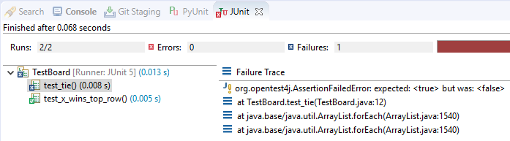
Unit Tests
class TestBoard {
@Test
void test_tie() {
Board board = new Board();
board.setToken(0,Token.X);
// MORE HERE
assertTrue(board.getStatus()==Status.TIE);
}
@Test
void test_x_wins_top_row() {
Board board = new Board();
board.setToken(0,Token.X);
board.setToken(1,Token.X);
board.setToken(2,Token.X);
assertTrue(board.getStatus()==Status.WON_X);
}
}
Java
Board board = new Board();
board.setToken(0, Token.X);
board.setToken(3, Token.O);
board.setToken(1, Token.X);
board.setToken(4, Token.O);
board.setToken(2, Token.X);
Status stat = board.getStatus();
System.out.println(stat);
Java

Slide 16
Player
import java.util.Scanner;
public class HumanPlayer {
Scanner in = new Scanner(System.in);
public HumanPlayer() {
// Maybe a name attribute?
}
public int getMove(Board board, Token token) {
board.print();
System.out.println("Your move player "+token);
int ret = in.nextInt();
// @todo error check and loop back
return ret;
}
}
Java

Slide 17
Types of Players
Board board = new Board();
HumanPlayer player1 = new HumanPlayer();
HumanPlayer player2 = new HumanPlayer();
//MrRandom player2 = new MrRandom();
// Who cares what player1 and player2 are?
// As long as they have "getMove" ...
// No way to say "player2 can be HumanPlayer OR MrRandom".
// We must pick a single type for variable "player2"
while(true) {
int move = player1.getMove(board, Token.X);
board.setToken(move, Token.X);
move = player2.getMove(board, Token.O);
board.setToken(move, Token.O);
}
Java
I don’t care what type this object is. I just care that it has a “getMove” method.
I don’t care what the method does. All I care about is the name.
And arguments.

Slide 18
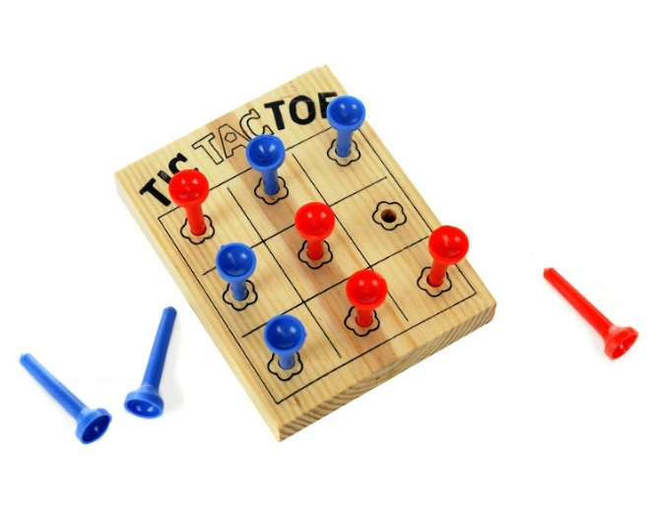
Tinkering
Make a program that plays four games at once.
Create 3 players to participate in the four games. Let them be ‘X’ in some games and ‘O’ in others.
Prompt the players one at a time for their move.

